Slide 1
Chapter 9 – Gaseous Exchange in Humans

Slide 2
9.1 The Human Respiratory System
You should be able to:
■ describe gaseous exchange in humans and explain its importance;
■ describe structural adaptations of the human respiratory system for efficient gaseous exchange;
■ describe the breathing mechanism in humans; and
■ distinguish between respiration and breathing.

Slide 3
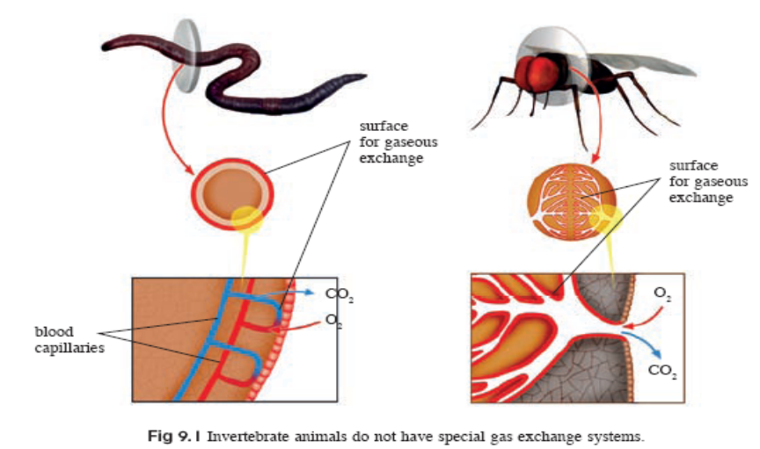
9.1 The Human Respiratory System
Importance of Gaseous Exchange in Humans
For respiration – to produce energy needed for growth, repair and movement; a continuous supply of oxygen is required and carbon dioxide, formed as a waste product, needs to be removed.
Unicellular organisms and invertebrate animals have a large surface area to volume
ratio and thus do not require
any special gas exchange
system.

Slide 4
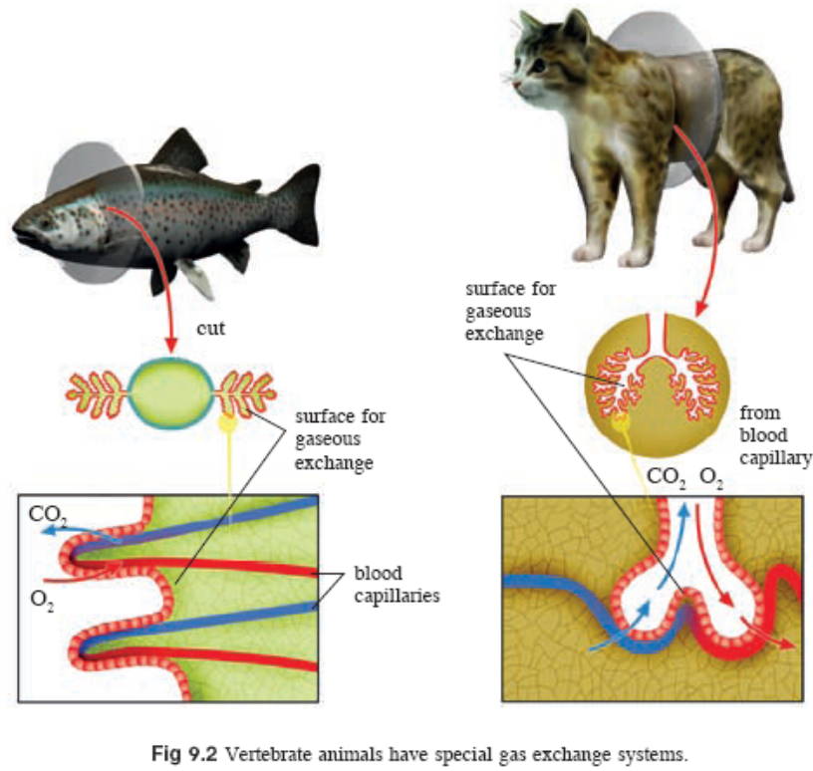
9.1 The Human Respiratory System
Importance of Gaseous Exchange in Humans
Vertebrate animals such as fish, amphibians and mammals have a small surface area to volume ratio. They have special structures
such as lungs or gills, which
have a large surface area for
gaseous exchange to occur.

Slide 5
9.1 The Human Respiratory System
Importance of Gaseous Exchange in Humans
A gas exchange system is important to ensure that oxygen can be absorbed and carbon dioxide removed rapidly.
Breathing mechanisms also help to bring about this rapid exchange of gases between the animals and their surroundings.

Slide 6
9.1 The Human Respiratory System
The Human Respiratory System
The respiratory system is responsible for gaseous exchange in man.
It includes the two lungs in the chest cavity (thorax) and the air passages leading to them.
Air enters lungs through the nostrils and mouth.
These lead into the pharynx, larynx, trachea and bronchi (singular: bronchus).
Each bronchus enters the lungs and divides repeatedly into smaller tubes called bronchioles which then end up as thin-walled air sacs called alveoli.

Slide 7
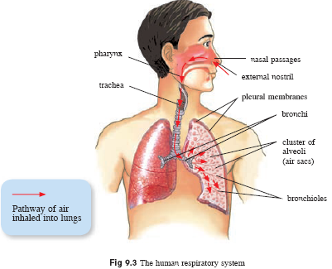
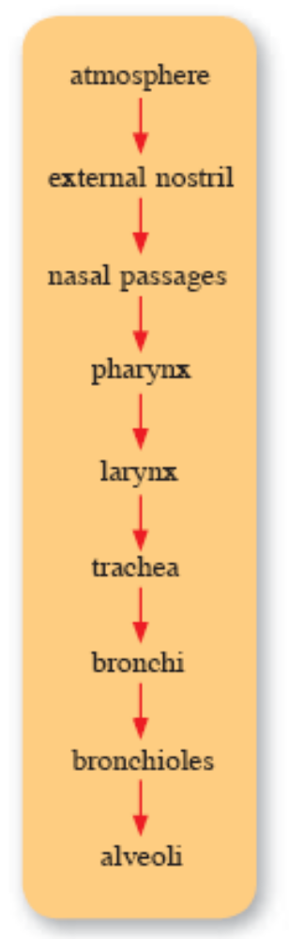
9.1 The Human Respiratory System

Slide 8
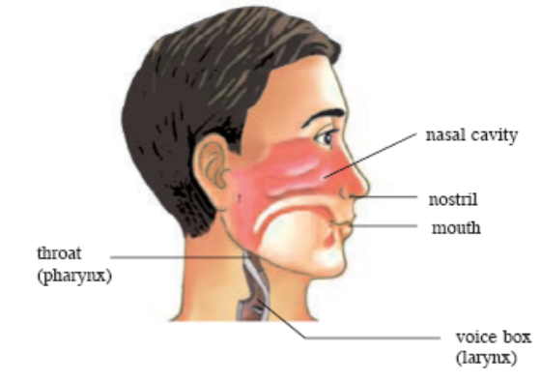
9.1 The Human Respiratory System
From nose to trachea
As air enters the nose, hairs lining the nasal passages + mucus secretions filter and trap any dust and foreign particles, including bacteria.
Air is also warmed and moistened as it passes through the nasal passages.
From the pharynx, air passes into the larynx, also known as the voice box, and then into the trachea.

Slide 9
9.1 The Human Respiratory System
From trachea to bronchi
The trachea, also known as the windpipe, is a rigid muscular tube which lies in front of the oesophagus (see Chapter 7).
It is supported by rings of C-shaped cartilage which give it rigidity to stay open for air to pass through.
The trachea then divides into the left and right bronchi which are also supported by rings of cartilage.

Slide 10
9.1 The Human Respiratory System
From trachea to bronchi
The epithelial cells along the walls of the trachea and bronchi contain goblet cells that secrete mucus to trap dust and foreign particles.
The epithelial cells also have hair-like structures on their surfaces, called cilia, which move in a wave-like manner, sweeping mucous up the trachea and into the pharynx. From there, the mucous is either coughed out or swallowed into the oesophagus.

Slide 11
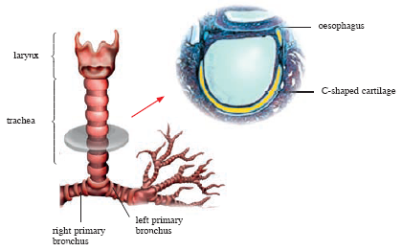
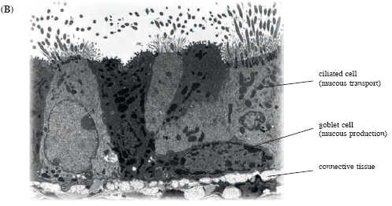
Fig 9.4 (A):
Cross-section of trachea
Fig 9.4 (A):
Ciliated cells and goblet cells

Slide 12
9.1 The Human Respiratory System
The lungs
The lungs are surrounded by two transparent elastic membranes called the pleura or pleural membranes.
A thin layer of pleural fluid between the membranes provides lubrication for the membranes to slide over each other as the lungs expand and contract during breathing.
The thorax is bounded within the rib cage and the diaphragm separates the thorax from the abdomen below.

Slide 13
9.1 The Human Respiratory System
The lungs
There are thousands of alveoli in the lungs and are the sites of gaseous exchange.
The alveoli are surrounded by a network of capillaries.
The walls of the alveoli are only one-cell thick and are permeable to oxygen and carbon dioxide.
Elastic fibres are also present in the walls of the alveoli that allow the alveoli to expand and recoil easily during breathing.

Slide 14
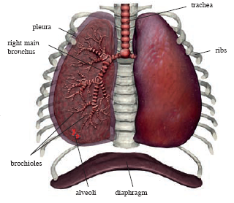
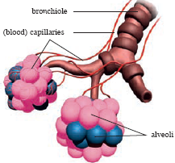
Fig 9.5: Structure of the lungs in man
Fig 9.6: Structure of alveoli

Slide 15
9.1 The Human Respiratory System
The lungs
Gaseous exchange at the alveoli takes place by diffusion (see Chapter 4).
Atmospheric air breathed into the alveoli of the lungs has a higher oxygen and lower carbon dioxide concentration than the blood in the capillaries surrounding each alveolus.
Thus, oxygen and carbon dioxide diffuse down this concentration gradient.

Slide 16
9.1 The Human Respiratory System
The lungs
Oxygen in the alveoli dissolves in the moisture lining the alveolar walls and diffuses into the blood in the surrounding capillaries.
It then combines with the haemoglobin present in red blood cells and is transported to respiring cells in the body (see Chapter 8).
Carbon dioxide diffuses out of the blood in the capillaries and into the alveoli.

Slide 17
9.1 The Human Respiratory System
The lungs
The concentration gradients between the alveolar
air and the blood are maintained by:
• the continuous flow of blood through the capillaries;
• the continuous breathing of air in and out of the alveoli.

Slide 18
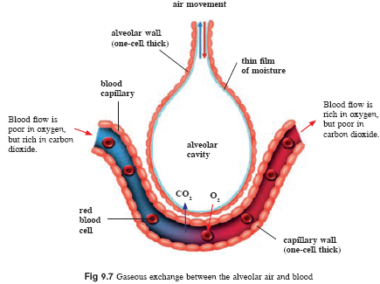

Slide 19
9.1 The Human Respiratory System
The lungs
Adaptations of the alveoli for efficient gaseous exchange:
• The numerous alveoli in the lungs provide a large surface area for gaseous exchange.
• Their walls are only one-cell thick to allow rapid gaseous exchange.
• Their walls have a thin film of moisture so that gases can dissolve in it and diffuse easily across the walls.
• They are surrounded by capillaries to maintain the concentration gradient of gases for diffusion to occur.

Slide 20
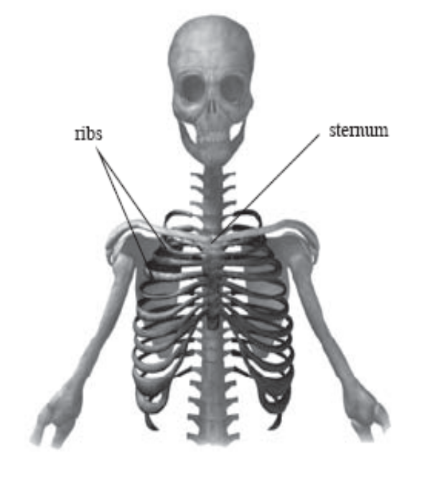
9.1 The Human Respiratory System
The Breathing Mechanism in Humans
In a vertebrate,
the rib cage – a set of bones forming
protective cage around the organs in
the upper body, especially the heart
and lungs.
it is attached to the spine
(vertebral column) and chest
bone (sternum)
Men and women both have
24 ribs arranged as 12 pairs.

Slide 21
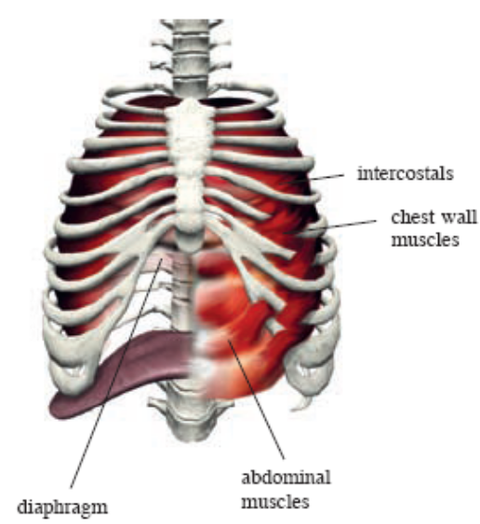
9.1 The Human Respiratory System
The Breathing Mechanism in Humans
Between the ribs are the intercostal muscles. There are two sets of muscles, the external and internal intercostal muscles, which work as antagonistic muscles.
A dome-shaped sheet of muscle called the diaphragm separates the thorax from the abdomen.
When the diaphragm contracts, it
flattens downwards and when the
diaphragm relaxes, it arches
upwards again.

Slide 22
9.1 The Human Respiratory System
The Breathing Mechanism in Humans
The ribs, intercostal muscles and the diaphragm are important in gaseous exchange as they help in moving air in and out of the lungs.
Movement of air occurs from a region of higher air pressure to a region of lower air pressure.
Changes in the volume of the thorax causes a difference in the air pressure in the lungs and atmosphere.
This pressure difference drives the movement of air in and out of the lungs.

Slide 23
9.1 The Human Respiratory System
The breathing mechanism involves two stages:
Inspiration (breathing in): During this process, the
thorax enlarges and increases in volume, which causes air
pressure in the lungs to decrease, thus drawing in air from
the atmosphere into the lungs.
To enlarge the thorax,
• the external intercostal muscles contract and the internal intercostal muscles relax, making the ribs move upwards and outwards;
• the diaphragm contracts and flattens.

Slide 24
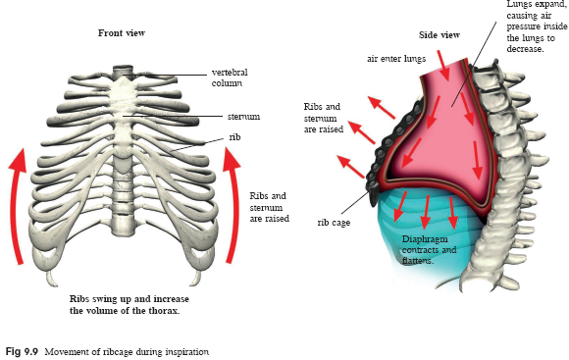

Slide 25
9.1 The Human Respiratory System
The breathing mechanism involves two stages:
Expiration (breathing out): During this process,the
thorax decreases in volume to its normal size,this causes air
pressure in the lungs to increase, thus forcing air out of the
lungs to the atmosphere.
To do this,
• the external intercostal muscles relax and the internal intercostal muscles contract, making the ribs move downwards and inwards to its original position;
• the diaphragm relaxes and arches upwards.

Slide 26
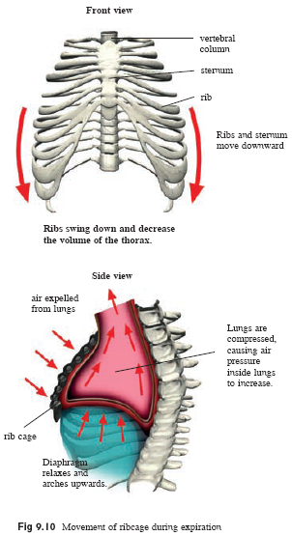

Slide 27
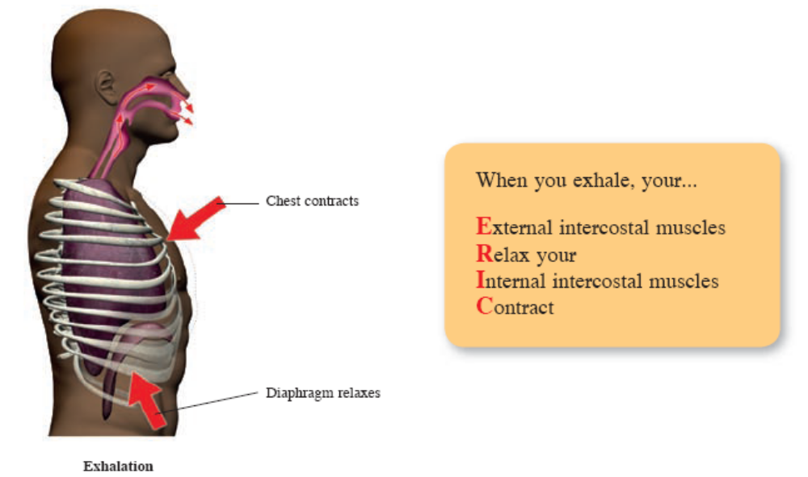

Slide 28
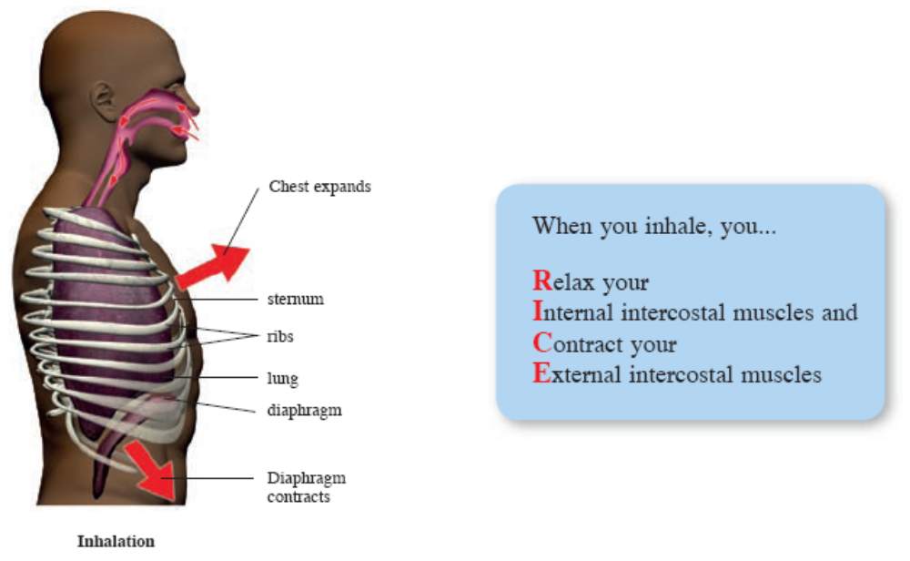

Slide 29
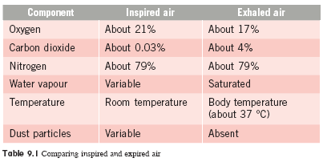
9.1 The Human Respiratory System
How Does Inspired Air Differ from Expired Air?

Slide 30
9.2 Respiratory Diseases
You should be able to:
■ discuss the effects of cigarette smoking.

Slide 31
9.2 Respiratory Diseases
Respiratory Diseases
Tobacco smoke contains up to 4000 different chemicals, some of which are harmful to your health and reduces life expectancy.
The three important chemicals linked to health problems are described in the following table:

Slide 32
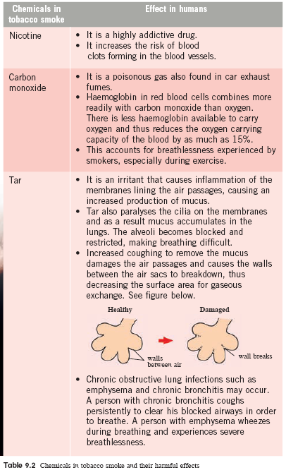

Slide 34
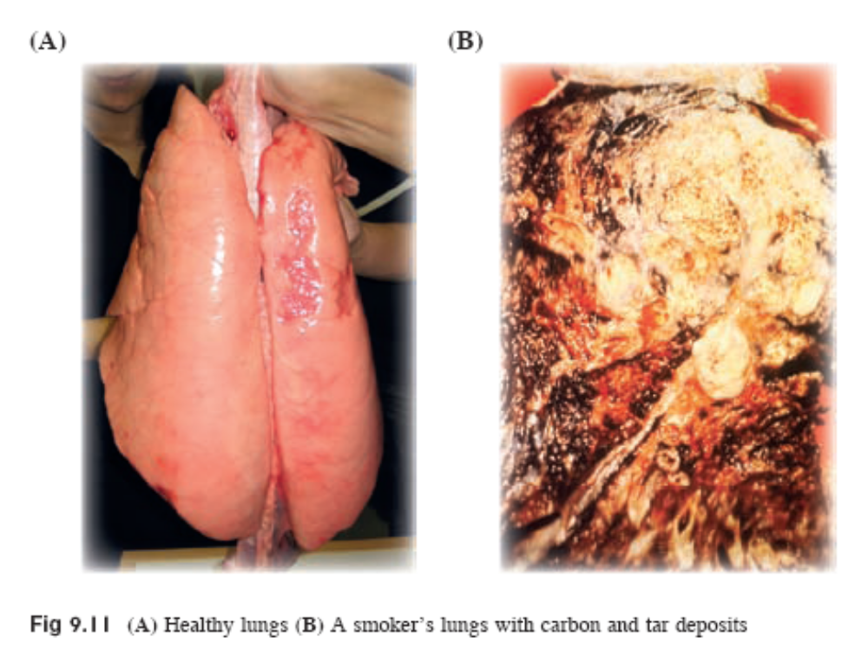

Slide 35
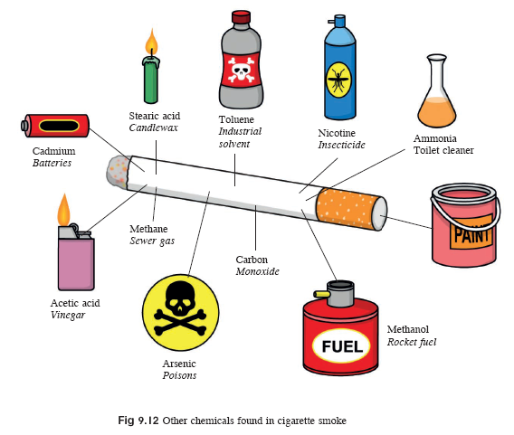

Slide 36
9.2 Respiratory Diseases
Lung Cancer
>80% of all lung cancer deaths are caused by smoking and a quarter of all smokers die of this cause.
Tobacco smoke contains carcinogens (cancer-causing factors) and may cause cancer, which is the uncontrolled division of cells, forming tumours or lumps of tissues.
Apart from lung cancer, smoking also increases the risk of cancers of the throat, mouth, bladder, kidney and pancreas.

Slide 37
Key Concepts
Larger animals such as fish, amphibians and mammals have special structures such as lungs or gills, to increase their surface area to volume ratio for gaseous exchange to occur.
A gas exchange system is important to ensure that oxygen can be absorbed and carbon dioxide removed rapidly.
Air is warmed and moistened as it enters the nose. Hairs lining the nasal passages together with mucus secretions filter and trap any dust and foreign particles.
From the nose, air passes into the pharynx, larynx, trachea and bronchi.

Slide 38
Key Concepts
The trachea and bronchi are supported by rings of cartilage, which give it rigidity to stay open for air to pass through.
Epithelial cells along the walls of the trachea and bronchi contain goblet cells that secrete mucus and have hair-like structures called cilia, which sweeps the mucus out of the air passages.
Each bronchus enters the lungs and divides repeatedly into smaller tubes called bronchioles which then end up as air sacs called alveoli.
Gaseous exchange at the alveoli takes place by diffusion. The alveolar walls are very thin, moist and well supplied with blood capillaries.

Slide 39
Key Concepts
Atmospheric air breathed into the alveoli has a higher oxygen and lower carbon dioxide concentration than the blood in the surrounding capillaries. Thus oxygen in the alveoli diffuses into the blood and is transported to respiring cells. Carbon dioxide diffuses out of the blood and into the alveoli.
Breathing, which consists of inspiration and expiration, helps to bring about rapid exchange of gases between the animals and their surroundings.

Slide 40
Key Concepts
During inspiration, the volume of the thorax increases due to the contraction of the diaphragm and external intercostal muscles. This causes air pressure in the lungs to decrease, thus drawing in air from the atmosphere into the lungs.
During expiration, the volume of the thorax decreases due to the relaxation of the diaphragm and contraction of the internal intercostal muscles. This causes air pressure in the lungs to increase, thus forcing air out of the lungs to the atmosphere.
Tobacco smoke contains several harmful chemicals such as nicotine, carbon monoxide and tar which increase the risk of lung cancer and other respiratory diseases such as emphysema and chronic bronchitis.

Slide 41
Key Concepts
Carbon monoxide reduces the oxygen carrying capacity of the blood and causes breathlessness during exercise.
Tar paralyses the cilia lining the air passages, enlarges the alveoli, thus reducing the surface area for gaseous exchange.
Tobacco smoke contains carcinogens and may cause cancer.

